Slide 1
Educator’s Qiskit
Making life easier for educators using Qiskit
IBM Q Services Kick-Off 2019 Hackathon

Slide 2

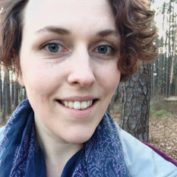
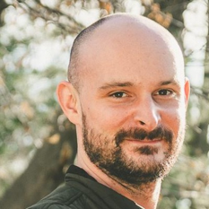
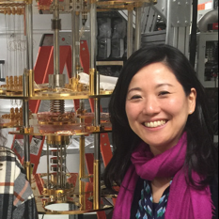
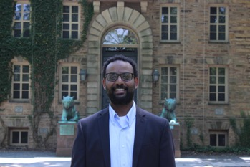

Team Members
James Wootton
Laura Zdanski
Paul Kassebaum
Yuri Kobayashi
Abraham Asfaw
Leron Gil

Slide 3
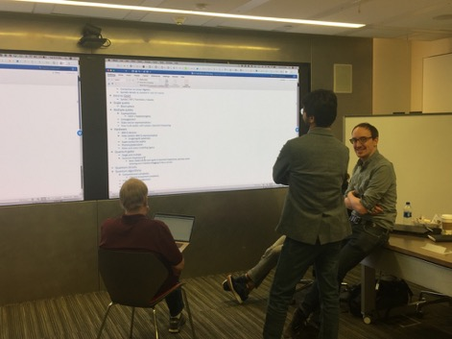
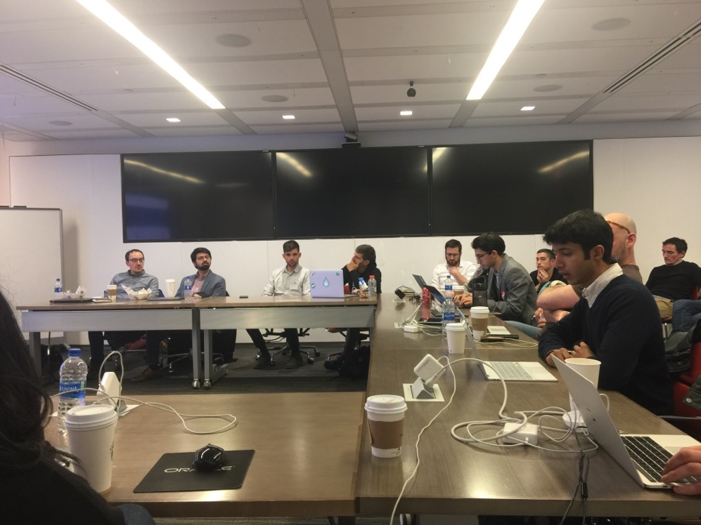
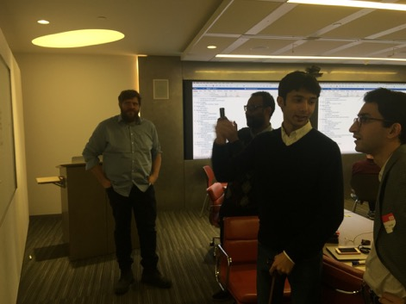
Educators Workshop with Harvard, Princeton, NYU and Yale
Computer Science Team
Undergrad Physics Team
Educators Workshop

Slide 4
Opportunity
Qiskit is an awesome educational tool.
But there are lots of opportunities where we can better accommodate the needs of educators and students in their journey.

Slide 5
Lessons Learned
Tutorial content visible and structured in a way that is easier for educators to build their curriculum
Simpler programming experience for first-time users
Stable instance of Qiskit that does not break during the academic calendar

Slide 6
Qiskit/Q Experience is an awesome educational tool.
Great tutorial contents and features – but are not noticed
Frustration with low visibility
Course materials and code generated in the past no longer works
https://github.com/veenaiyuri/qiskit-education

Slide 7
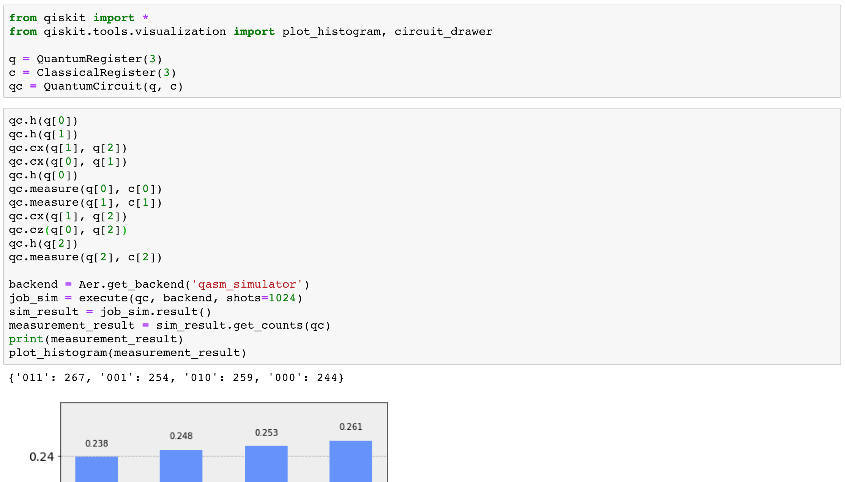

Slide 8
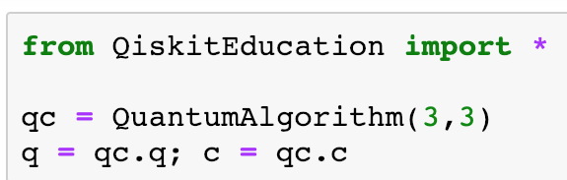
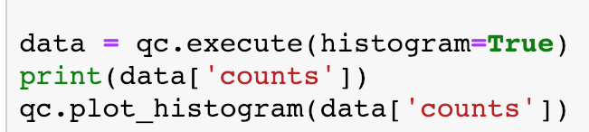

Slide 9
Minimal qiskit syntax, emphasis on quantum computation + education
User sees no changes in QiskitEducation even if there are changes in qiskit-terra

Slide 10
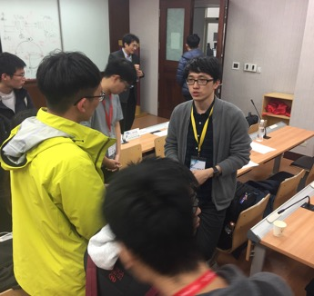
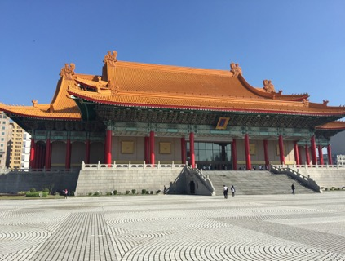
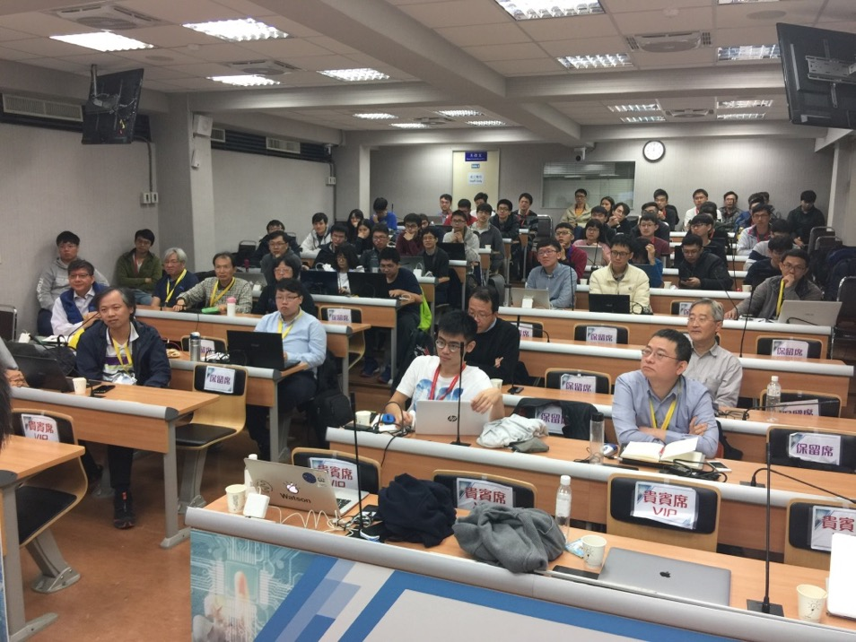
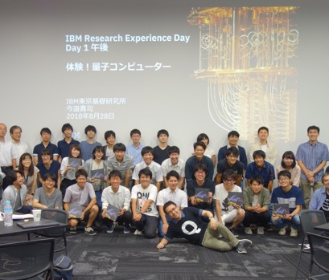
Localized content improves accessibility

Slide 11
Goals for first MVP and for the future
Create initial version of Educator’s Qiskit
Invite select faculty members for beta testing and gather feedback
Integration with IQS in the future

